Slide 1
Student Capstone Experiences (Youth Intern, Senior Experience, Entrepreneurship Experience, Service Learning, & Youth Apprenticeship)
Fall 2022
Name:

Slide 2
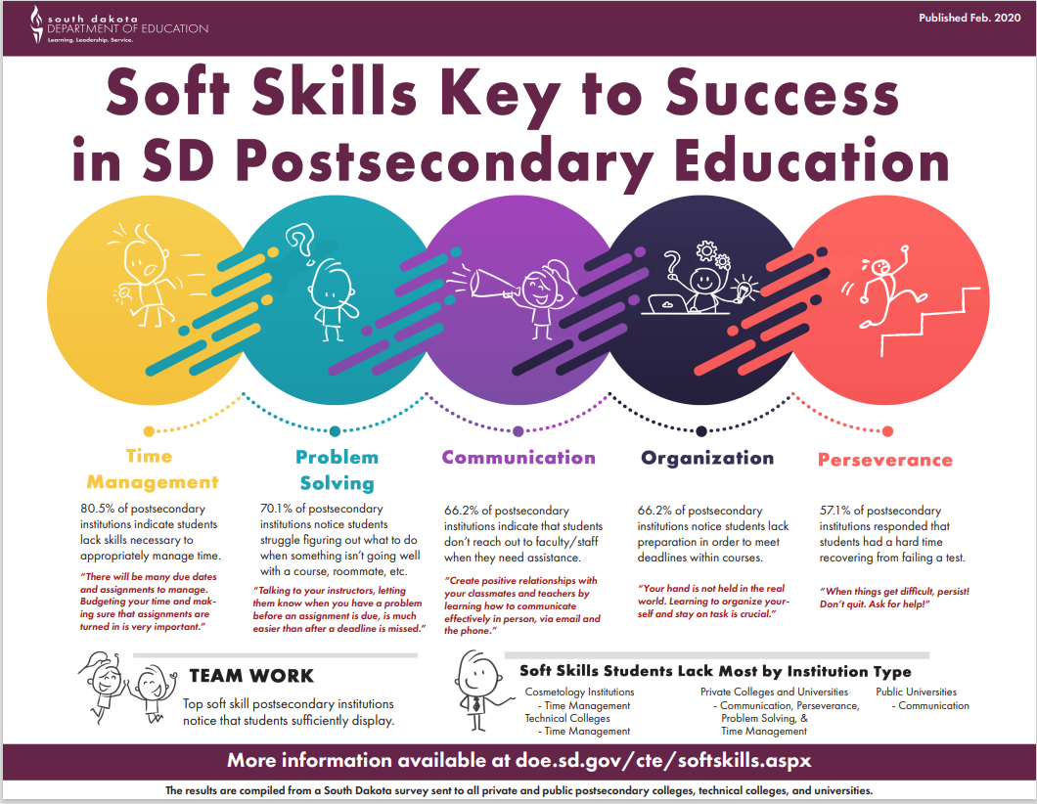

Slide 3
Service Learning Job
After visiting with your Capstone Experience Advisor, who is: _______________, list 3-5 goals that you’d like to achieve from this experience.

Slide 4
Direct Experience Supervisor
Name & Title:
(Note: Capstone Advisor & Experience Supervisor may be the same person.)
What are some professional observations about your supervisor that were helpful in this experience:

Slide 5
Service Learning Hours of Work
Put Schedule Below – Days & Times

Slide 6
Responsibilities – Duties of the Job

Slide 7
Pictures of mE Doing My job

Slide 8
Reflection of the Experience
List how you were able to improve your soft skills and then insert a video or audio recording of you describing what you did and learned. Must be at about 3 minutes.
What did you like best?
What did you like least?
What was your biggest learning moment?
What were the 2 main soft skills you used most?

